Slide 1
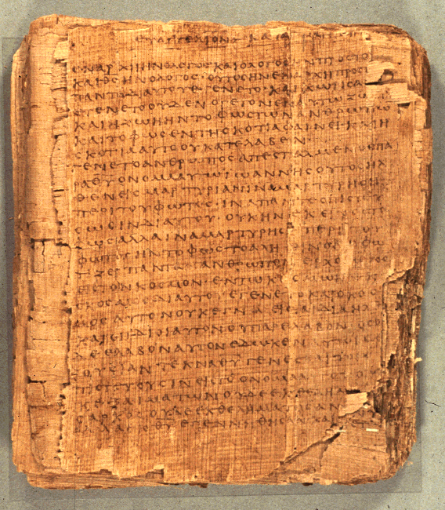
How to Read the Psalms
Dr. Rodney K. Duke

Slide 2
CLASS 2
Assign: (see handout)
Write a journal reflection entry (for each class)
Assignment #2. Discover the formal elements of different kinds of psalms. Compare and contrast 6 psalms, forming 3 sets of pairs based on common characteristics.
[Following “footsteps” of Hermann Gunkel]
Day Objectives:
Observe theological reflection through narrative, Psalm 73
Compile tentative description of psalms\
Describe how psalms functioned in the Temple setting.
Define “cult” and identify Israelite cultic elements.
Notes:
Gunkel and rise of social sciences.

Slide 3

PSALM 73
Type: Wisdom / Didactic
Issue: theodicy (problem of evil and suffering)
Form: reflective narrative of experience w/maxim as confession

Slide 4
JOURNAL THOUGHTS, OBSERVATIONS, & QUESTIONS

Slide 5

REVIEW
Assignments: to make and “own” one’s observations
Journal reflection: essential step of learning.
Understanding HOW a text communicates is essential to understanding WHAT it communicates.
“Cultic” a term for ways one expresses religion
Oral compositions, (although written down) use different literary techniques from written compositions
Biblical interpretation (exegesis): Methodologically, this course is about learning to apply sophisticated communication skills you already have, which one has acquired perhaps un-consciously over time, metacognitively.
“Meaning” is the total impact of text as generated by form and content.

Slide 6
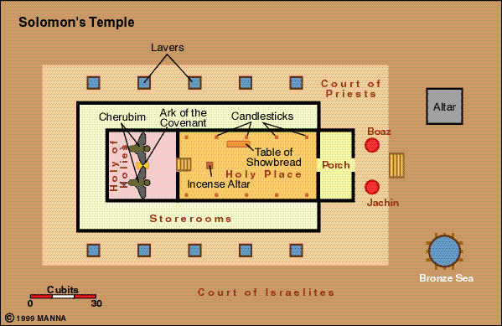
Using the Bible to compute π

Slide 7
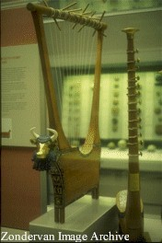
Group Work on #1: Using your assignment observations, combine your results to create a tentative literary description.
What rhetorical intentions is/are the speakers trying to achieve?
What can we observe about the speakers?
What can we observe about the addressees?
What means (strategies, features) are employed?
What kind of referent (topics, themes)?
------------------
Your main observations and questions?
Lyre, used for the queen of Ur

Slide 8
Assign. #1: Observations about Rhetorical Intentions
[Preparation for Assign. #2]
2/3 of all psalms have one of 3 Rhetorical Intentions:
get God to do something,
thank God for something already done,
praise God in general for God’s nature.
Doing Assign. #2. Look for formal features such as:
rhetorical intention
mood, mood shift
temporal orientation of the speaker
addressee, addressee shift

Slide 9
APPLICATION OF PROCESS OF COMMUNICATION
When reading a specific OT text:
General
1. Identify the literary genre and its function(s) in general.
2. Identify the general literary features of that genre and their intended impact. (Create a "Reading Strategy")
Specific
3. Identify the literary features of a specific text and their specific impact. (Apply Reading Strategy)
4. Evaluate in terms of intended function/impact.

Slide 10
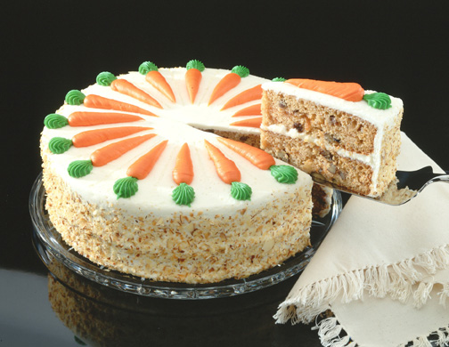
Genre Recognition
Failure to employ a reading strategy that recognizes the types/genres of literature in the Bible and their original functions:
1. Obscures the variety of forms employed in the Bible and makes communication MORE difficult. (People employ different genres to AID communication.)
2. Locates the meaning of the text in the hands of the reader (leading to unintended applications) rather than locating the meaning in the author’s intention.
3. Promotes private and self-centered readings of the Bible (“God speaks to ME”), rather than an informed and communally guided interpretation.
4. Often leads to an “atomizing” of the text. (Illustration: favorite cake)
The form and function of the biblical text should influence the form and function of the sermon.

Slide 11
NATURE OF THIS CLASS
Our literary goal will be to define and describe the psalms by discovering the following information:
Speaker, audience, means, referent.
Rhetorical intention
Rhetorical strategies
Literary features and their intended impact
Guidelines for reading and application
Historical context (relationship to ANE lit., authorship or origin, setting of use and/or transmission, etc.)
Theological basis and/or themes

Slide 12
Define “Cult”/“Cultic”
Any tangible expressions of religion (rituals, gestures, places, objects, personnel, seasons, etc.)

Slide 13
Today Ancient Israel
Rituals
Gestures
Places
Objects
Personnel
Seasons

Slide 14
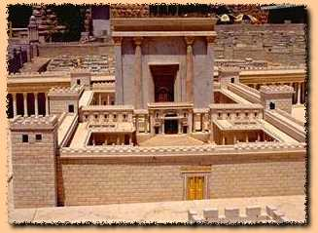
How to Read the Book of Psalms?
Psalms are NOT simply poems or songs.
They were functional songs: “cultic” expressions of faith – part of various religious rituals in specific settings for specific purposes.
How do cultic elements in your church setting aid people to worship God?
Notes:
Might compare to church baptismal rituals.

Slide 15
Overview
Setting of transmission and employment
1. Whatever the origin of the Psalms, they seem to have been used in the Temple worship as collected “books” of psalms.
2. The Psalms as we have them have been made very generic: enemies, illnesses, threats, occasions of joy, etc. are stated in general terms.
3. As a result, the Psalms have become applicable to all people.

